Slide 1
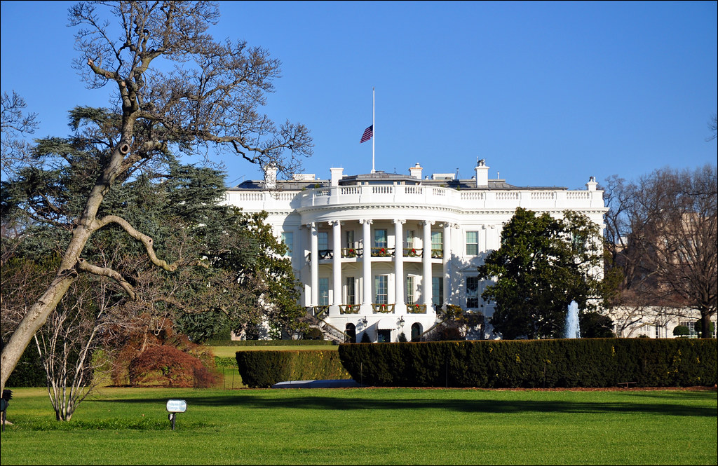
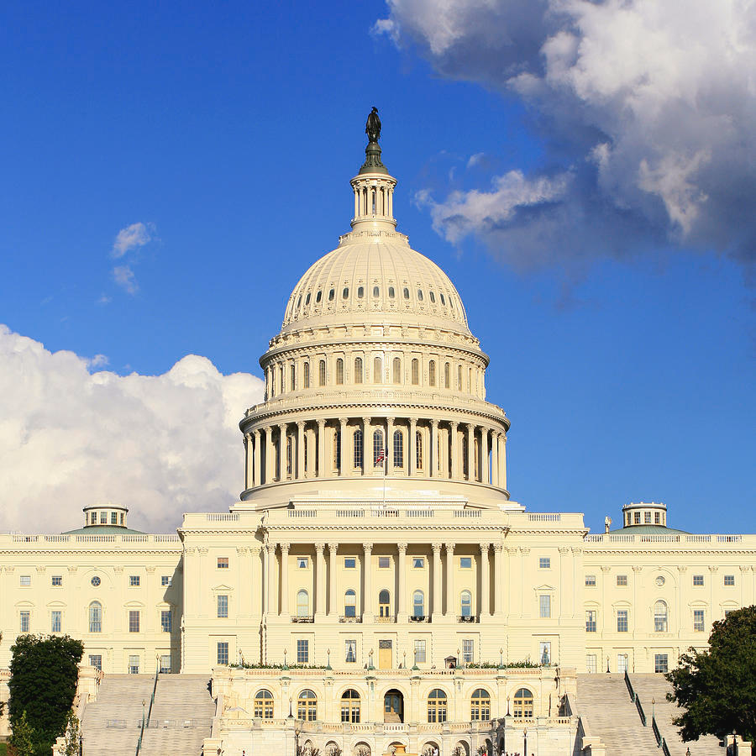
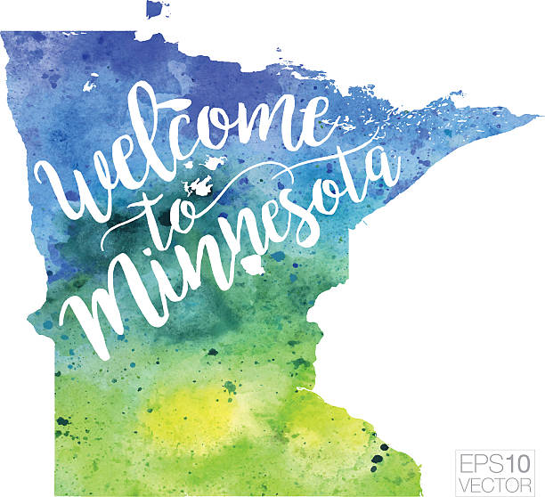
American Rescue Plan Act (ARPA) Funding and Potential Opportunities for Nonprofits
Thursday, July 14 2022

Slide 2
Introduction: Anne Kilzer and Kari Aanestad,
Minnesota Council of Nonprofits
ARPA Overview
Three Types of Support in Minnesota
Federal Program-Specific Funding
Q&A
State Fiscal Recovery Fund
Local Fiscal Recovery Fund
Jill Suurmeyer, Association of Minnesota Counties
Wrap Up
Steve Fenske, Minnesota Association of Townships
Lisa Sova, League of Minnesota Cities
Our Agenda:

Slide 3
MCN Member Support: COVID Recovery Response
The Minnesota Council of Nonprofits (MCN) is here to support nonprofits seeking American Rescue Plan Act (ARPA) funding as well as advocating on your behalf with state and local government.
ARPA Funding Project
Supported with funding from the McKnight Foundation
Governor’s Council on Economic Expansion
MCN advocated for basic safety and security people need to be able to return to the workforce and/or volunteer in our communities
Includes Affordable Housing, Childcare, Eldercare, Heathcare, etc.
Race Equity
Scaling and funding of nonprofits as part of the solution
…And more!

Slide 4
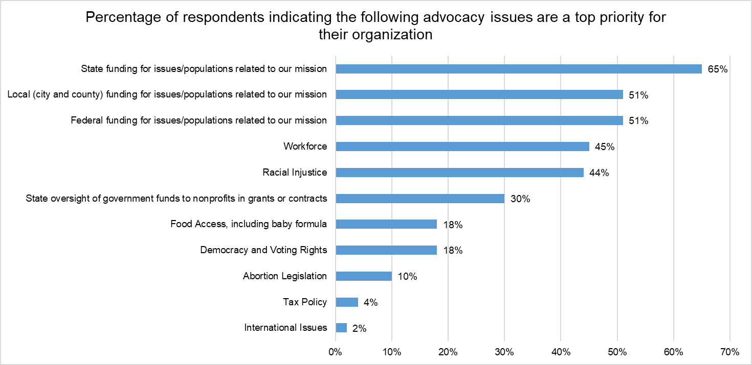
MCN Survey- Preliminary Results (still in progress)

Slide 5
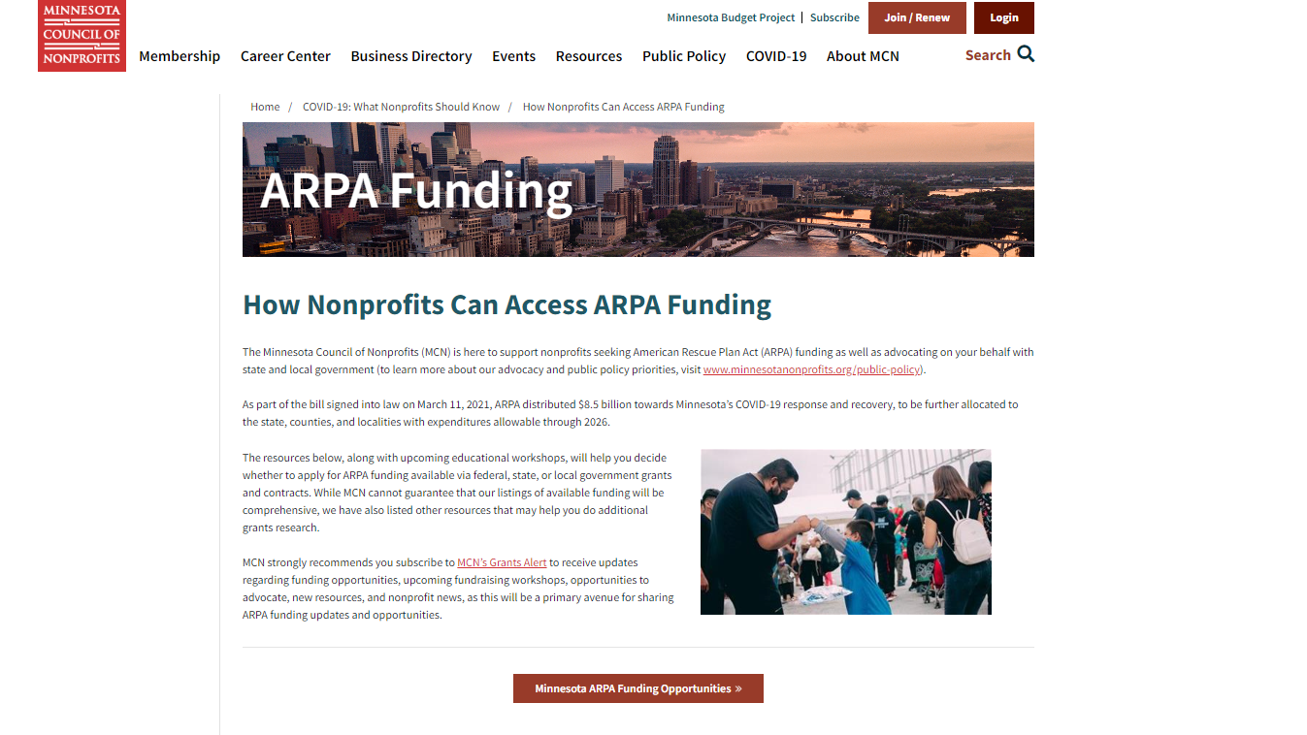
How Nonprofits Can Access ARPA Funding (minnesotanonprofits.org)

Slide 6
The purpose of the American Rescue Plan Act - often referred to as “ARP” or “ARPA” – is:
to provide fast and direct economic assistance for American workers, families, small businesses, and industries. The American Rescue Plan continues many of the programs started by the Coronavirus Aid, Relief, and Economic Security (CARES) Act of 2020 and Consolidated Appropriations Act (2021) by adding new phases, new allocations, and new guidance to address issues related to the continuation of the COVID-19 pandemic.
Generally speaking, ARPA funding has a longer timeframe for planning, implementation and spending than initial relief programs allowed.
ARPA creates a variety of new programs to address continuing pandemic-related recovery as the United States begins to emerge from the COVID-19 pandemic.
The American Rescue Plan was passed by Congress on March 10, 2021 and signed into law on March 11, 2021.

Slide 7
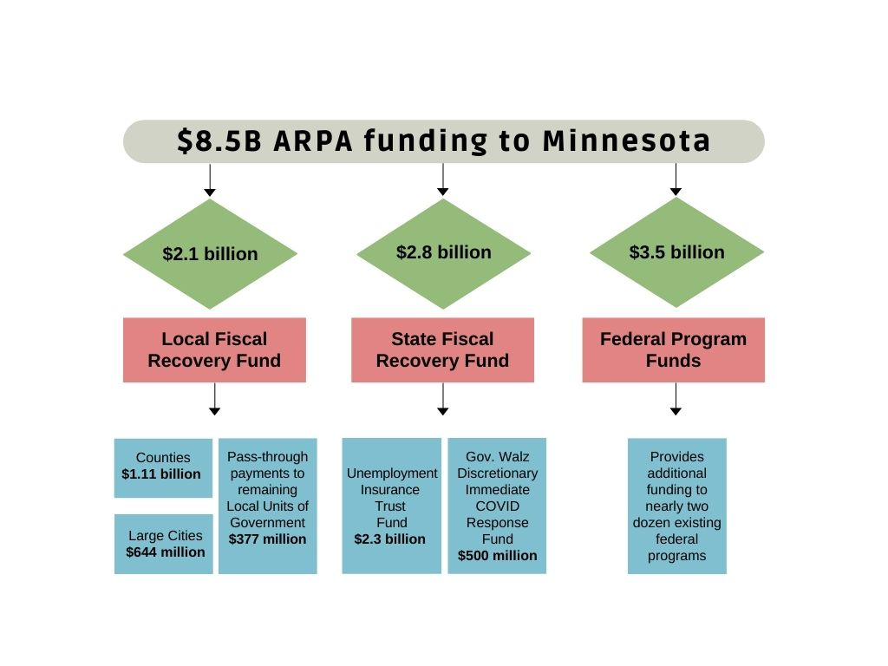
The American Rescue Plan invests $8.5 billion in Minnesota’s COVID-19 response and recovery.

Slide 8
Nonprofit organizations qualify for ARPA Funding
BUT….
…. unlike state and local governments, they did not receive the money directly from the U.S. Department of the Treasury.
Instead, nonprofits can secure the federal relief money through either their local governments or programs receiving ARPA allocations from the state.
Nonprofits may also partner in projects that are directly funded by the Federal Government.

Slide 9
How can ARPA Funding Be Used?
A fact sheet published by the US Department of Treasury provides a detailed description of these uses:
Support public health expenditures, by, for example, funding COVID-19 mitigation efforts, medical expenses, behavioral healthcare, and certain public health and safety staff.
Address negative economic impacts caused by the public health emergency, including economic harms to workers, households, small businesses, impacted industries, and the public sector
Replace lost public sector revenue, using this funding to provide government services to the extent of the reduction in revenue experienced due to the pandemic.
Provide premium pay for essential workers, offering additional support to those who have and will bear the greatest health risks because of their service in critical infrastructure sectors.
Invest in water, sewer, and broadband infrastructure, making necessary investments to improve access to clean drinking water, support vital wastewater and stormwater infrastructure, and to expand access to broadband Internet.

Slide 10
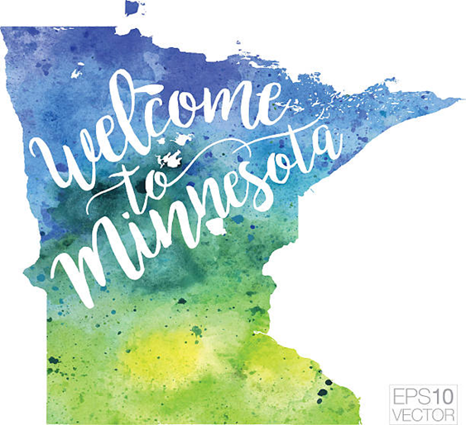
Federal Program-Specific Funding
Amount: $3.505 Billion
Decision Making Authority:
Federal Government
(No discretion over allocations at state level).

Slide 11
Federal Program-Specific Funding: Supporting Working Families
Supplemental Discretionary Child Care Development Block Grant: $202 Million
Mandatory Child Care Development Funds: $9.2 Million Increase
Child Care Stabilization Grant Funding: $324.1 Million
Women, Infants, & Children (WIC) Supplement: $8.2 Million
Low Income Home Energy Assistance Program (LIHEAP): $167 Million
Pandemic Emergency Assistance: $14.3 Million
Older Adults (Misc.): $23.1 Million
Child Abuse Prevention: $4.4 Million
Emergency Rental Assistance: $229 Million
Homeowner Assistance Fund: $128 Million
HOME Investment Partnerships: $31 Million
Federal Program Funds / Minnesota Management and Budget (MMB) (mn.gov)

Slide 12
Federal Program-Specific Funding:
Ensuring Students Catch Up on Learning
Elementary and Secondary School Emergency Relief: $1.3 Billion
Emergency Assistance to Nonpublic Schools: $37.7 Million
Library Services and Technology Grants: $3.2 Million
Special Education – IDEA: $52.4 Million
Homeless Children and Youth: $8.7 Million
Pandemic Electronic Benefit Transfer (P-EBT): $14.3 Million
School COVID-19 Testing: $169.9 Million
Federal Program Funds / Minnesota Management and Budget (MMB) (mn.gov)

Slide 13
Federal Program-Specific Funding: Supporting Small Business and Driving Economic Recovery
State Small Business Credit Initiative: $75.3 Million
Statewide Transit Systems: $350.4 Million
Capital Projects: $179 Million
Federal Program Funds / Minnesota Management and Budget (MMB) (mn.gov)

Slide 14
Additional Help Administered
by the Federal Government:
Public Health Funds
COVID-19 Vaccination: $52.3 Million
Address COVID-19 Health Disparities Equity Cut-out: $25.1 Million
Prevention and Control of Emerging Infectious Disease: $4.1 Million
Supplemental Vaccination: $2.3 Million
Federal Program Funds / Minnesota Management and Budget (MMB) (mn.gov)

Slide 15
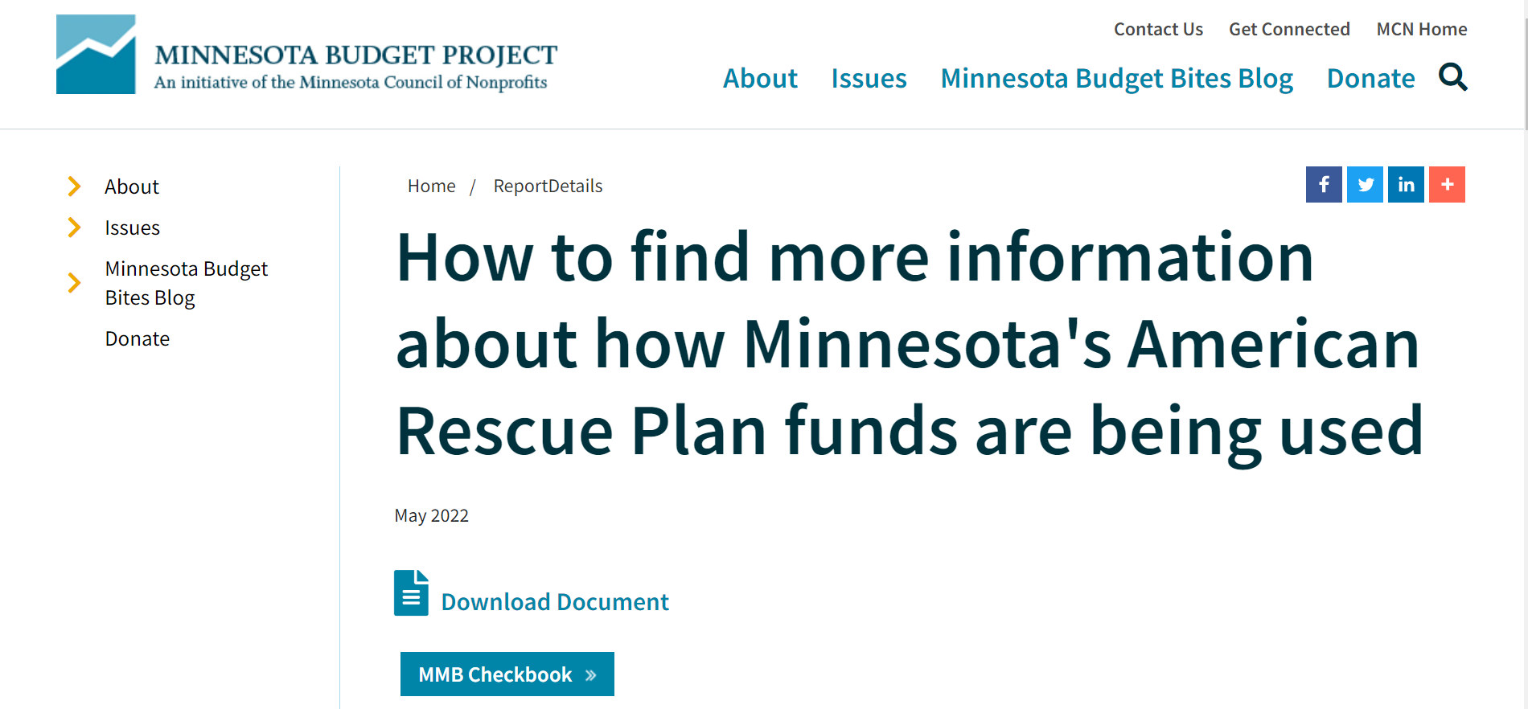
Transparency Minnesota / Minnesota Management and Budget (MMB) (mn.gov)

Slide 16
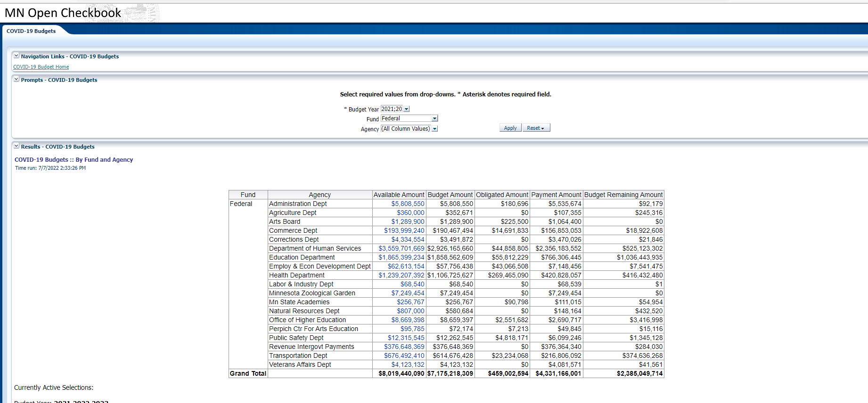
Federal Program-Specific Funding

Slide 17
Federal Program-Specific Funding
Remaining Funding = 30% 7/7/22

Slide 18
State Fiscal
Recovery Fund
Amount: $2.8 billion
Decision Making Authority:
Governor and Legislature
Allocated to two purposes:
Immediate COVID-19 response $500,000
Replenishment and repayment of the unemployment insurance trust fund $2.3 billion
Dedicating such a large portion of the State Fiscal Recovery Fund to one purpose greatly reduced opportunities for other programs and partnerships.

Slide 19
State Fiscal Recovery Fund: Immediate COVID Response
The governor and legislature agreed to allocate $500 million for addressing immediate COVID-19 response needs.
Expenditures exceeding $2.5 million are subject to the Legislative COVID-19 Response Commission (LCRC) review process.
All approved projects (77) can be viewed here: State Fiscal Recovery Fund / Minnesota Management and Budget (MMB) (mn.gov)
Monthly expenditure reports are available on the COVID-19 Response Accountability Office’s American Rescue Plan Reports webpage.

Slide 20
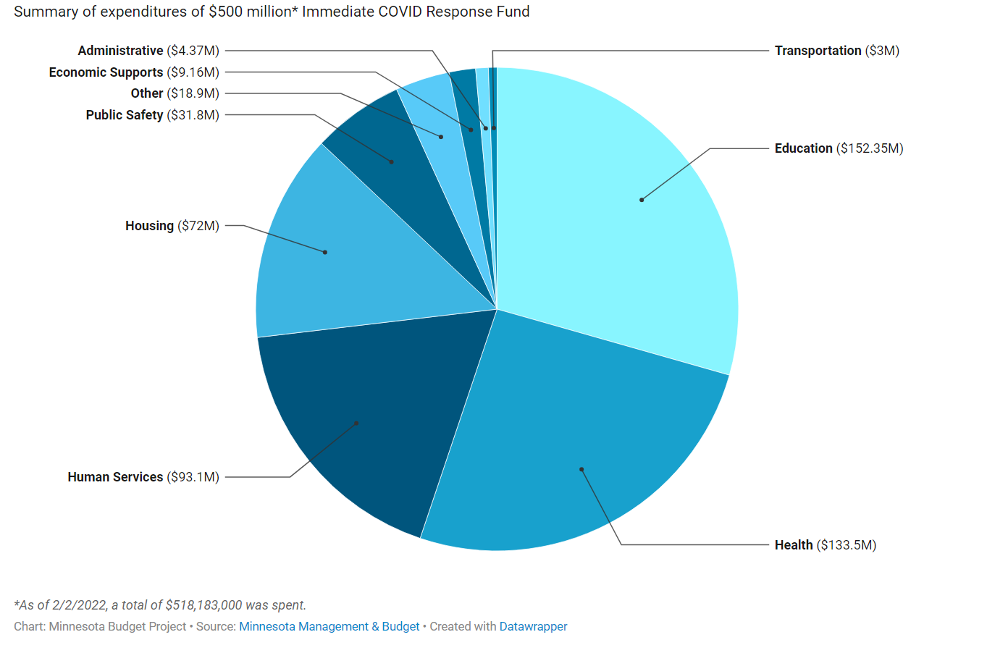
State Fiscal Recovery Fund: Immediate COVID Response

Slide 21
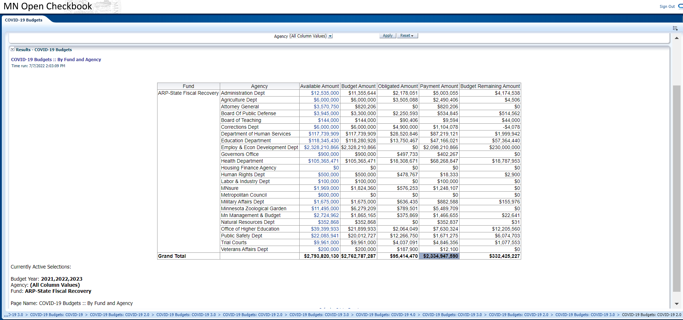

Slide 22
Remaining Funding = 11% 7/7/22

Slide 23
Local Fiscal
Recovery Fund
Amount: $2.1 billion
Decision Making Authority:
Local Units of Government
Direct Payments to Counties: $1.11 billion
Direct Payments to 21 large cities: $644 million
Pass-through payments to remaining cities and towns: $377 million
Entities receiving funding have from March 2021 through December 2024 to obligate funding; expenditures must be concluded by December 31, 2026.

Slide 24
Local Fiscal Recovery Funds
Remaining Funding = 79% 12/31/21. Data from reports submitted in April 2022 has not yet been posted.

Slide 25
Local Fiscal Recovery Funds… let’s hear from the experts!
Jill Suurmeyer, Association of Minnesota Counties
Steve Fenske, Minnesota Association of Townships
Lisa Sova, League of Minnesota Cities

Slide 27
For further information:
Kari Aanestad
kaanestad@minnesotanonprofits.org
Anne Kilzer
anne@capitolhillassoc.com

